Slide 1
Data Dive 5
Daniel Farone, Austin Fine,
Stiven LaVrenov, Caleb Reed

Slide 2
What can we determine from global happiness scores?
What year was the happiest (on average)?
How does the worldwide distribution of average happiness scores differ to the distributions of GDP and Population Density for the countries?
How are the average happiness scores distributed by world region?
What national demographics have the biggest correlation to happiness scores?
Can the scores for the region be explained through a region’s population demographics?
Can we predict average happiness scores across the globe for 2021?

Slide 3
What is the happiness score?
Cantril Self-Anchoring Scale
Ranges from 0 to 10
Respondents rank their own current lives
3 distinct groups
Thriving: 7 - 10
Struggling: 5 & 6
Suffering: 0 - 4

Slide 4
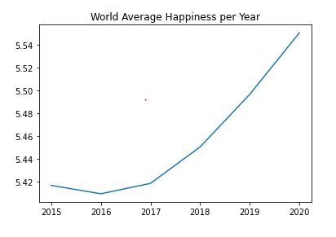
Happiness Score Over the Years
Slight drop in 2016 may be due to Zika virus pandemic, Brexit disputes in the EU, US election controversies, or drop in global GDP
Continuous increase from 2017 onward
Despite that, will 2020 pandemic affect 2021 scores?

Slide 5
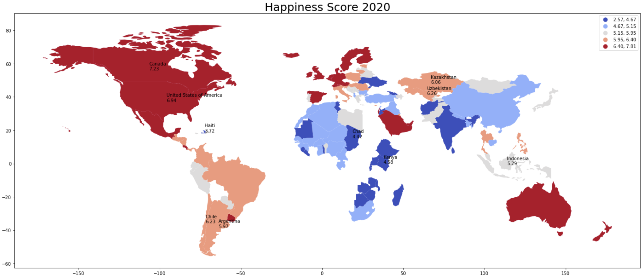
2020 Happiness Scores

Slide 6
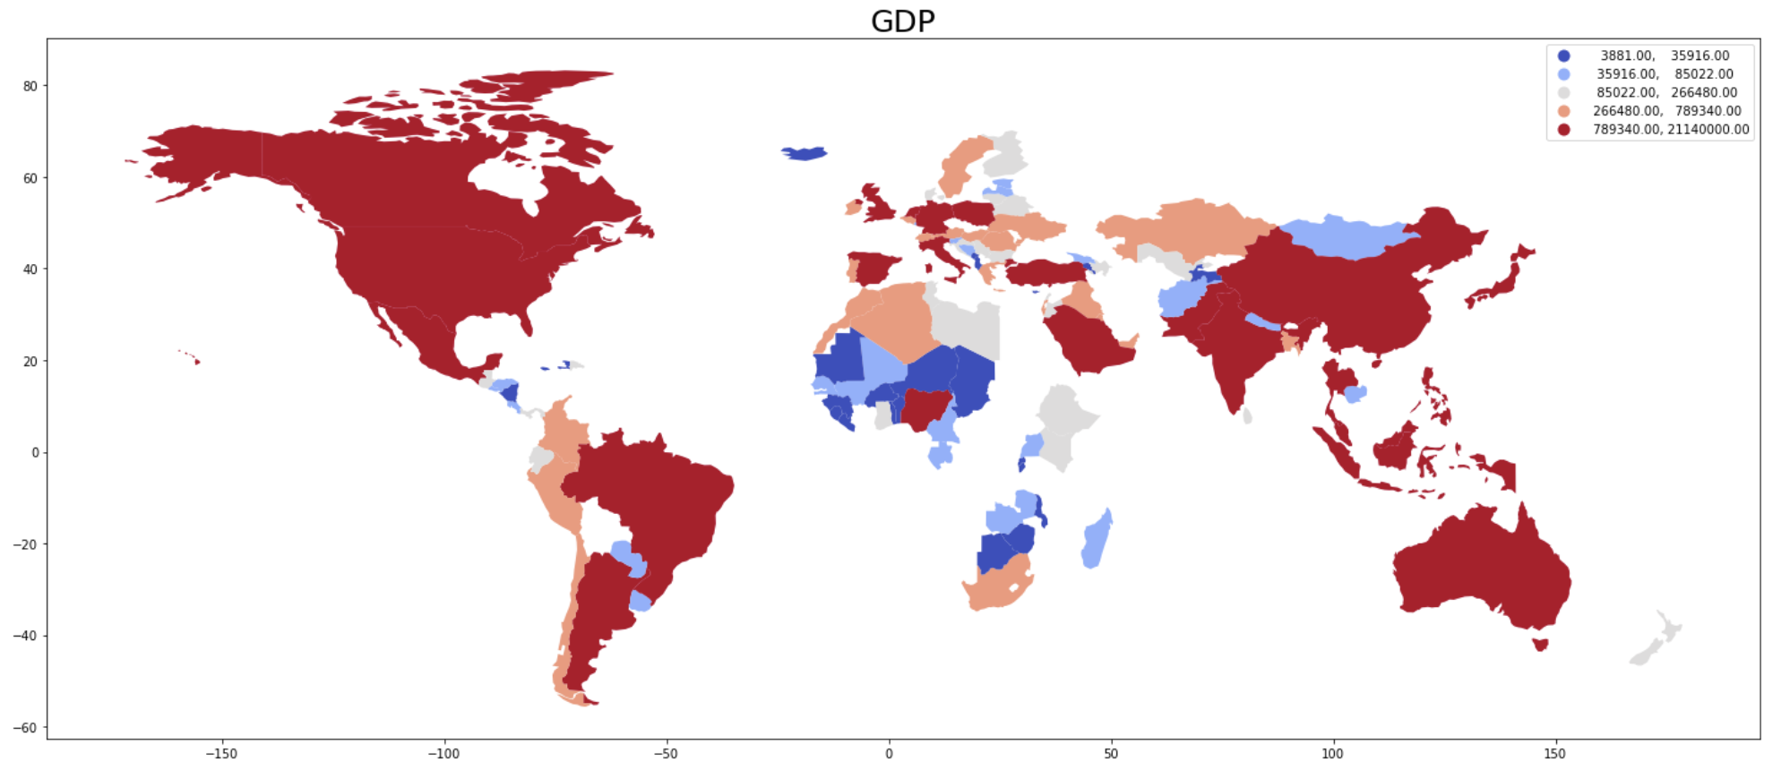
2020 GDPs

Slide 7
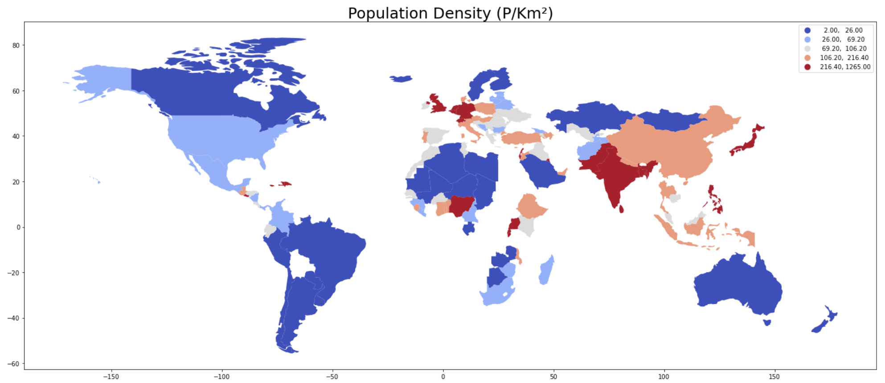
2020 Population Densities

Slide 8
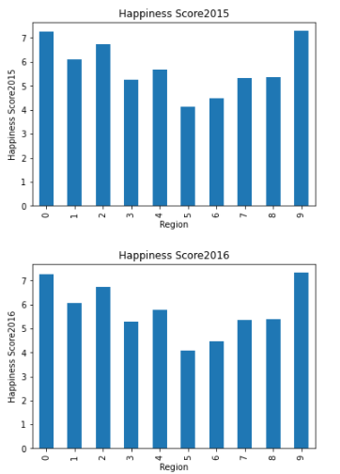
2015 & 2016 Scores
Region Legend
0: North America
1: Latin America & Caribbean
2: Western Europe
3: Central and East Europe
4: Middle East & Saharan Africa
5: Sub-Saharan Africa
6: South Asia
7: East Asia
8: Southeast Asia
9: Australia & New Zealand

Slide 9
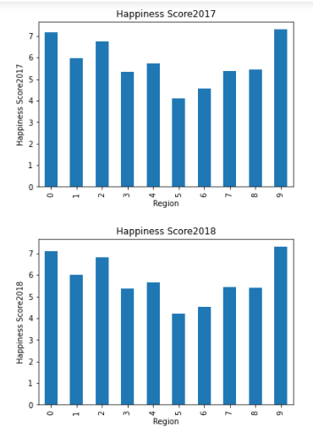
2017 & 2018 Scores
Region Legend
0: North America
1: Latin America & Caribbean
2: Western Europe
3: Central and East Europe
4: Middle East & Saharan Africa
5: Sub-Saharan Africa
6: South Asia
7: East Asia
8: Southeast Asia
9: Australia & New Zealand

Slide 10
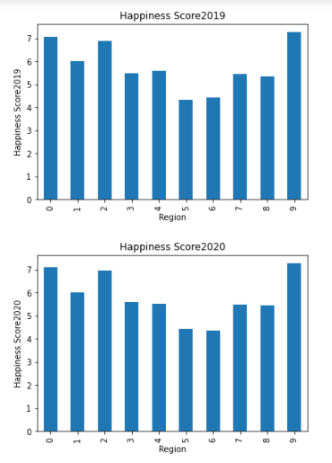
2019 & 2020 Scores
Region Legend
0: North America
1: Latin America & Caribbean
2: Western Europe
3: Central and East Europe
4: Middle East & Saharan Africa
5: Sub-Saharan Africa
6: South Asia
7: East Asia
8: Southeast Asia
9: Australia & New Zealand

Slide 11
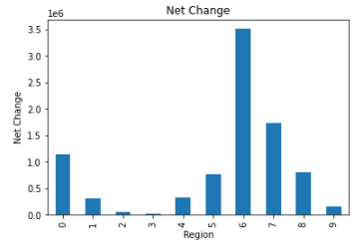
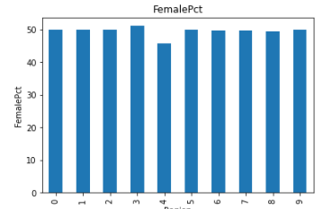
Net Change & Female %
Region Legend
0: North America
1: Latin America & Caribbean
2: Western Europe
3: Central and East Europe
4: Middle East & Saharan Africa
5: Sub-Saharan Africa
6: South Asia
7: East Asia
8: Southeast Asia
9: Australia & New Zealand

Slide 12
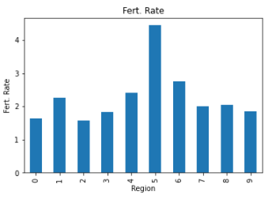
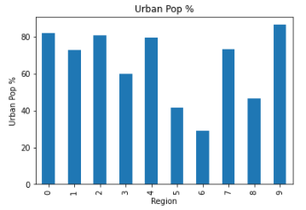
Fertility Rate & Urban Pop %
Region Legend
0: North America
1: Latin America & Caribbean
2: Western Europe
3: Central and East Europe
4: Middle East & Saharan Africa
5: Sub-Saharan Africa
6: South Asia
7: East Asia
8: Southeast Asia
9: Australia & New Zealand

Slide 13
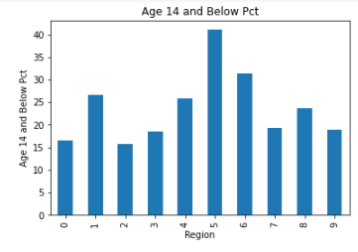
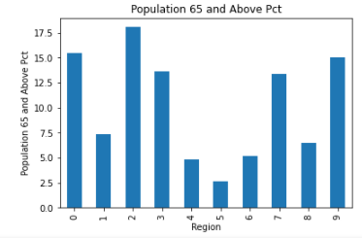
Age Demographics
Region Legend
0: North America
1: Latin America & Caribbean
2: Western Europe
3: Central and East Europe
4: Middle East & Saharan Africa
5: Sub-Saharan Africa
6: South Asia
7: East Asia
8: Southeast Asia
9: Australia & New Zealand

Slide 14
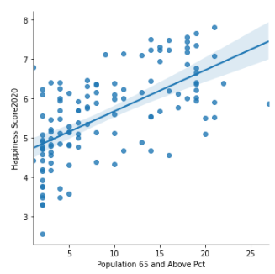
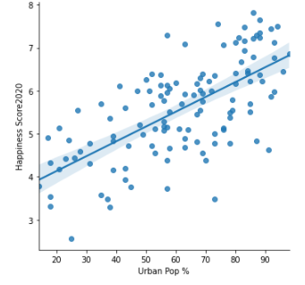
Urban Population % & Age 65 and Above
r = 0.62
r = 0.66

Slide 15
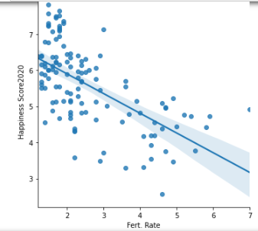
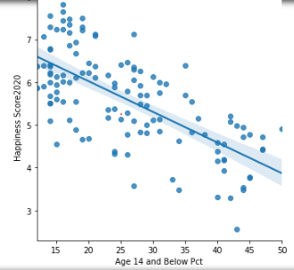
Fertility Rate & Age 14 and Below
r = -0.62
r = -0.68

Slide 16
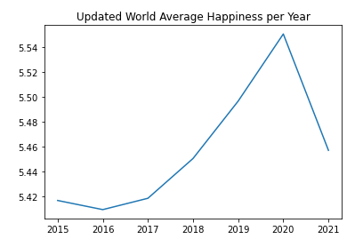
Predicted 2021 World Happiness Score
Based on our predictive model, there is a significant decrease in average global happiness for 2021
Average Happiness: 5.46
It’s likely COVID-19 played a significant role in this decrease

Slide 17
Conclusion
Happiest year (on average):
2020
GDP and population density follow an opposite trend across countries.
Highest happiness scores:
Region 0 (North America) & Region 9 (Australia & New Zealand)
Lowest happiness scores:
Region 5 (Sub-Saharan Africa) & Region 6 (South Asia)
Largest correlation:
Urban Population Percentage
Age 65+
2021 predicted happiness score:
5.46 (0.08 decrease from 2020)

Slide 18
Works Cited
World Happiness Report Data Set
https://www.kaggle.com/unsdsn/world-happiness?select=2019.csv
World Population 1960 - 2018 Data Set
https://www.kaggle.com/imdevskp/world-population-19602018?select=population_density_long.csv
2020 World Happiness Report
https://worldhappiness.report/ed/2020/
Cantril Self-Anchoring Scale
https://news.gallup.com/poll/122453/understanding-gallup-uses-cantril-scale.aspx
GDP Growth (annual %)
https://data.worldbank.org/indicator/NY.GDP.MKTP.KD.ZG?end=2020&start=2015
World Events
https://www.theatlantic.com/international/archive/2016/12/ten-most-significant-world-events-in-2016/511079/

